Slide 1

How do ELNs help
make your research FAIR?
Open https://pad.carpentries.org/record-keeping_08062021

Slide 2
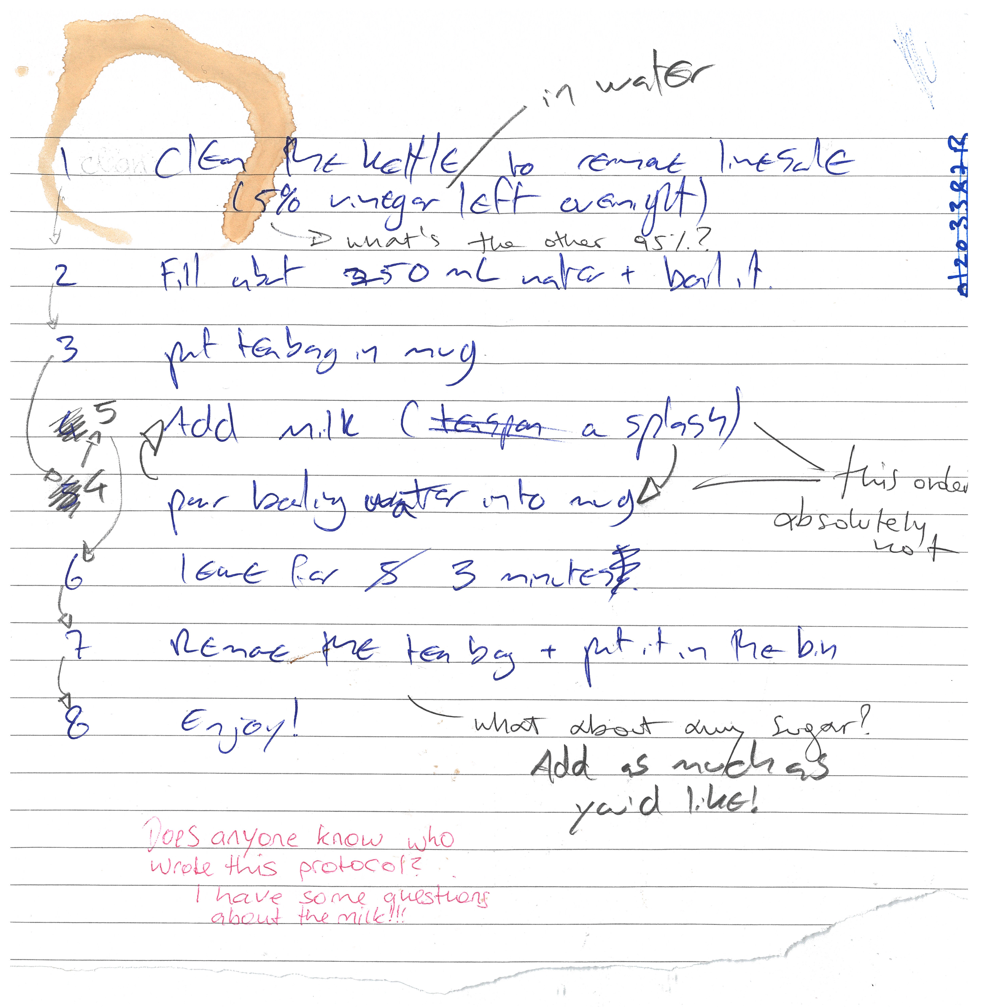
Before we start this session on good record keeping, it might be a good idea to make ourselves a cup of tea.
Here’s a peer-reviewed protocol
for making tea
Figure credits: Dr Ines Boehm and Ben Thomas

Slide 3
Exercise/challenge 1:
Differences between analogue and digital record keeping

Slide 4
Why do we need to keep good quality records?
Good scientific practice
Good record keeping ensures:
Transparency
Reproducibility
Accountability

Slide 5
How can we as a research community implement practices to make it easier to find manipulated records?
FAIR record keeping
In order to avoid data mismanagement and unexplained discrepancies, it is imperative to keep dated, accurate, complete and intelligible records of our experiments and the protocols we use. This means they should include enough detail for others to reproduce.
You are, legally, the one responsible for your records, not your colleague, or your PI.

Slide 6
How can we as a research community implement practices to make it easier to find manipulated records?
Both protocols and laboratory records need to be detailed and kept accurate and complete. They should be accessible (physically and/or electronically) to others both short and long term. Regular back-ups on a cloud and physical hard-drive are necessary to ensure appropriate archiving. All your records should be kept in compliance with departmental, institutional, and other regulatory requirements, with special care given to human and animal research records. A few common guidelines of good record keeping for protocols and laboratory notebooks are the following:
Laboratory Notebooks
contain all relevant details (what, when why and how you did it)
who you are (the person creating the record)
which project(s) is the record part of
information on lot/batch numbers
what happened and what did not happen (data, including images)
how you processed and analysed the data
your interpretation (and the interpretations of others if important) and next steps in the project based on these results
should be well organised for ease of navigation (indexed, labelled, catalogued)
accurate and complete: include all original data and important study details (metadata).
Protocols
who created the protocol if not you
complete and detailed instructions describing why and how to do an experiment
what special materials and instruments are being used and where they were obtained
health and safety advice and how to dispose of waste
allow repetition of your procedures and studies by yourself and others

Slide 7

Exercise/challenge 2:
Re-using a published lab entry

Slide 8
Exercise/challenge 3:
Adapting a protocol to your needs

Slide 9
Exercise/challenge 4:
Sharing your record

Slide 10

Exercise/challenge 5:
Adapt a public protocol and retain its provenance

Slide 11
How to chose the right platform?
There are more than a 100 platforms that provide services to host electronic lab notebooks or protocols, therefore it can seem quite daunting trying to find the right platform. There is some advice we can offer when looking for the right service.
Compliance with departmental, institutional, and other regulatory and legal requirements (including where data is geographically located, and which types of data can and cannot be stored).
Price (is it free?), check if your institution has a subscription to any.
Maturity of the ELN (is it a brand new ELN, or has it been established for a while now, i.e. is there a risk of the ELN disappearing & data being lost?).
Sharing & exporting capabilities, experience of colleagues, availability of support, integration with other relevant platforms (e.g. dropbox), and the potential for use with mobile devices if required?
What is the user interface like? Does it feel intuitive or does it take you days to find what you are looking for?
Check for operating system compatibility and real time collaboration.
Preferably it should be Open Source.
The BioRDM team has put together a summary of most used ELNs on the University of Edinburgh Wiki where they test-ran a handful of ELNs for you so you can make a more informed choice.

Slide 12
Exercise/challenge 6:
Do you use an ELN? Which one? What features do you like?

Slide 13
How does good record keeping help us get FAIR ready?
Accessibility of your protocols online allows to share them with collaborators who need them for a publication and a DOI of said protocols allows to cite them with credibility.
Electronic lab records allow for easier re-usability and access of your data across multiple platforms. Changes in your records can be traced back, therefore giving accountability.
Don’t forget
Take the Quiz
Feedback appreciated!

